Slide 1
Module 3 Project
Locale Effect on Healthcare Costs
Last Update: Aug 2019

Slide 2
Key Questions:
Metropolitan vs. Non-Metropolitan:
Is there a difference for hospital charges for the same procedures depending on location?
Is Medicare coverage affected by hospital location?
Are patients in Metro areas paying more than those in non-Metro areas?
What diagnosis categories have the largest location effect?

Slide 3
Data Sources
Inpatient Prospective Payment System (IPPS) Provider Summary for the Top 100 Diagnosis-Related Groups (DRG) - FY2016
Census data from 2010
Google Maps API
Census block geoid – Geo Locator API
Caveats
Old Data – 2010 Census & 2016 Hospital Charge Data

Slide 4
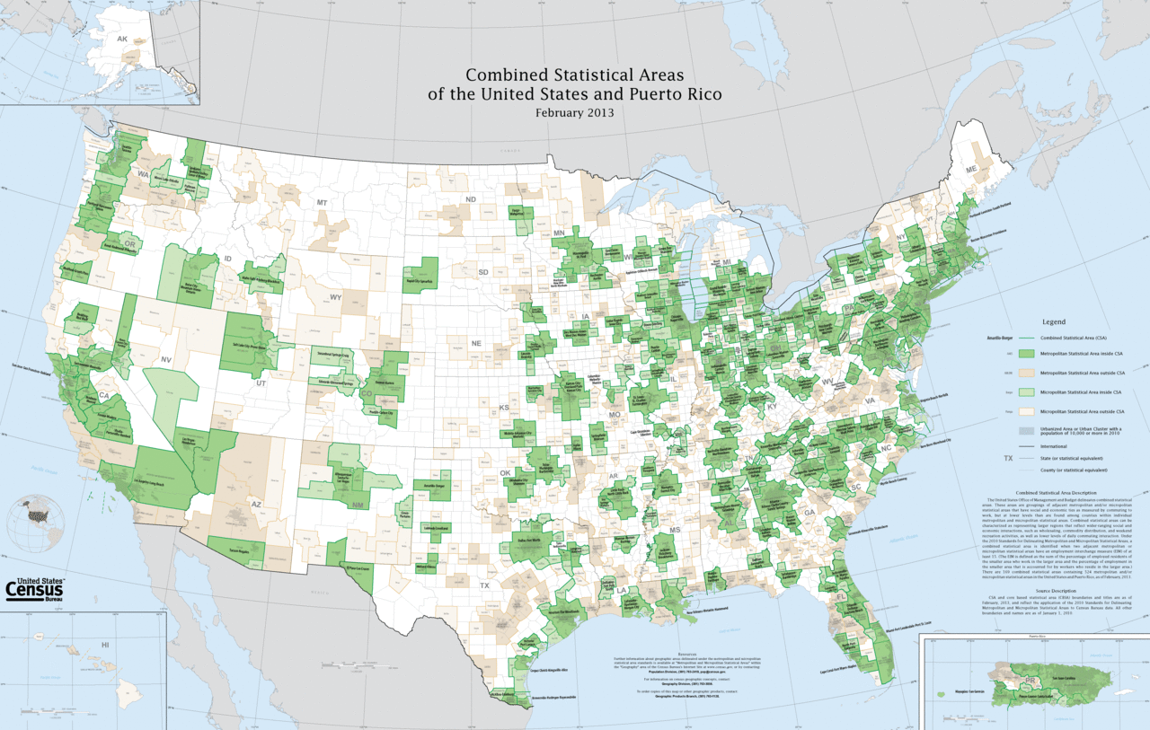
Metro vs. Non-Metro

Slide 5
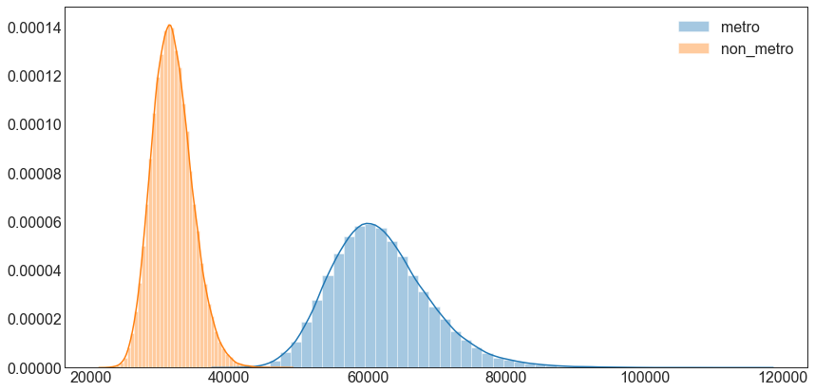
Average Hospital Charges
Hospital charges more for Medicare covered services in Metropolitan locations
Charges for Medicare services vary more in Metropolitan locations
Notes:
Source: Admissions training presentation and FAQ (July 2019)

Slide 6
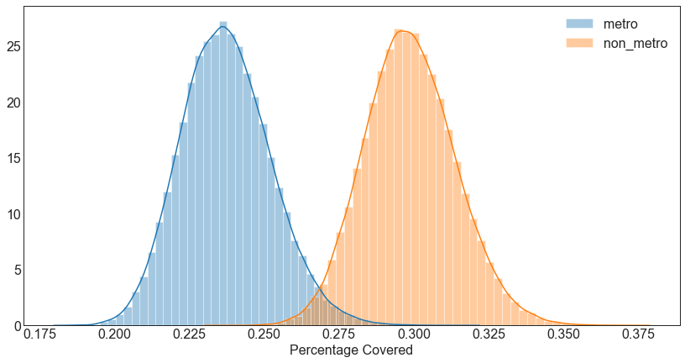
% Charges Paid for Treatment
Medicare pays a higher percentage of the hospital charge in non-Metro areas vs. Metro areas

Slide 7
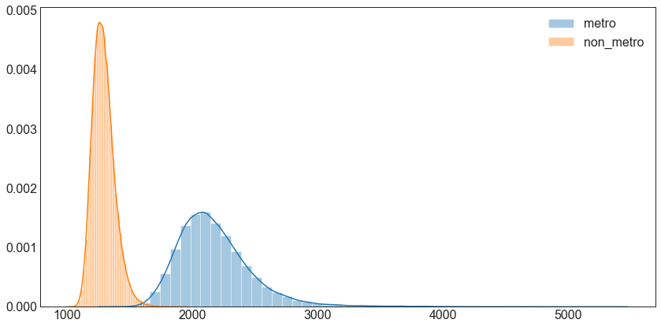
Out of Pocket
Patients who receive Medicare Services in Metropolitan areas pay more out-of-pocket than those in Non-Metropolitan areas
Notes:
Source: Admissions training presentation and FAQ (July 2019)

Slide 8
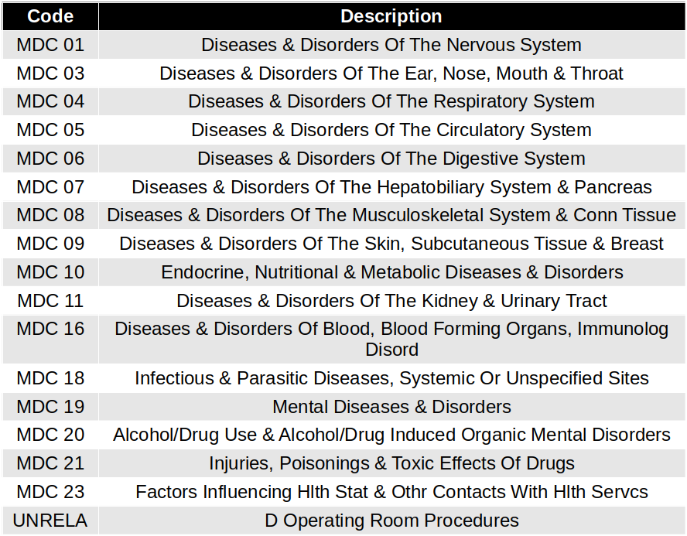
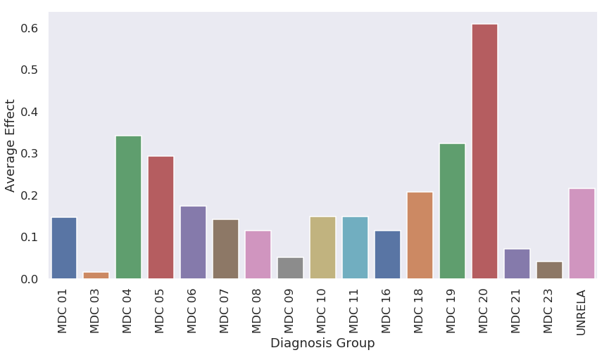
Locale effect per Diagnosis Type
Notes:
Source: Admissions training presentation and FAQ (July 2019)

Slide 9
Consider policy decisions to lower regional boundaries for alcohol/drug abuse and mental illness in urban areas (particularly regarding homelessness issues)
Consider legislation to standardize medical costs, especially within metropolitan areas
Recommendations

Slide 10
Investigate causation
Expand scope into diagnosis-specific location effects
Further categorize hospitals by different criteria (e.g. Teaching vs. Private, local economy, etc.)
Look into variation of medical costs within individual socioeconomic metropolitan areas
Further Research and Next Steps

Slide 11

Thank You!

